Slide 1
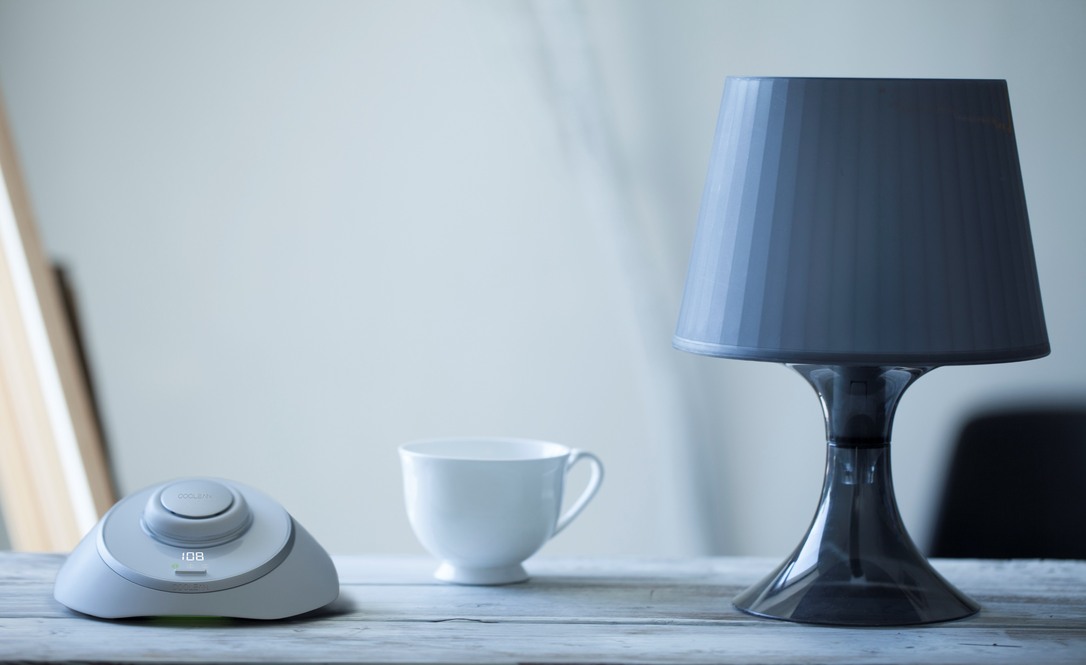

个人呼吸健康系统
Personal Air Cleaning System
Ye Zhao(赵冶)
Co-Founder & COO

Slide 2
What is COCLEAN?

Slide 3
COCLEAN is an air cleaner.

Slide 4
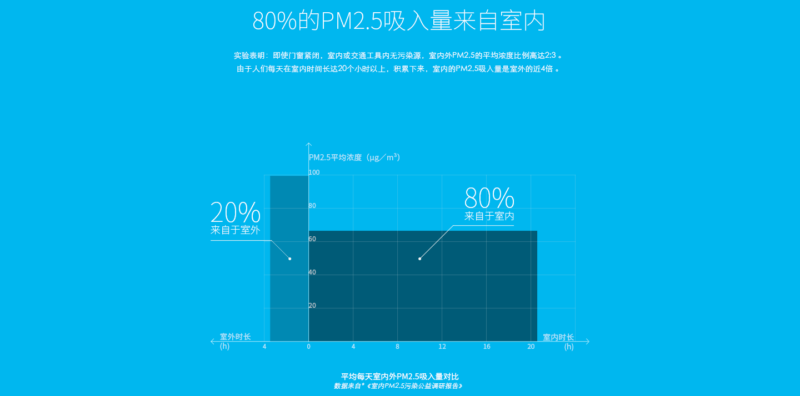
Problem: ~80% of Daily Dose of PM2.5 Attributes to Indoor
Problem
Notes:
I believe people in this room are all familiar with haze and other air quality problems. But, you may not know that according to peer-reviewed journal papers, around 80%...

Slide 5
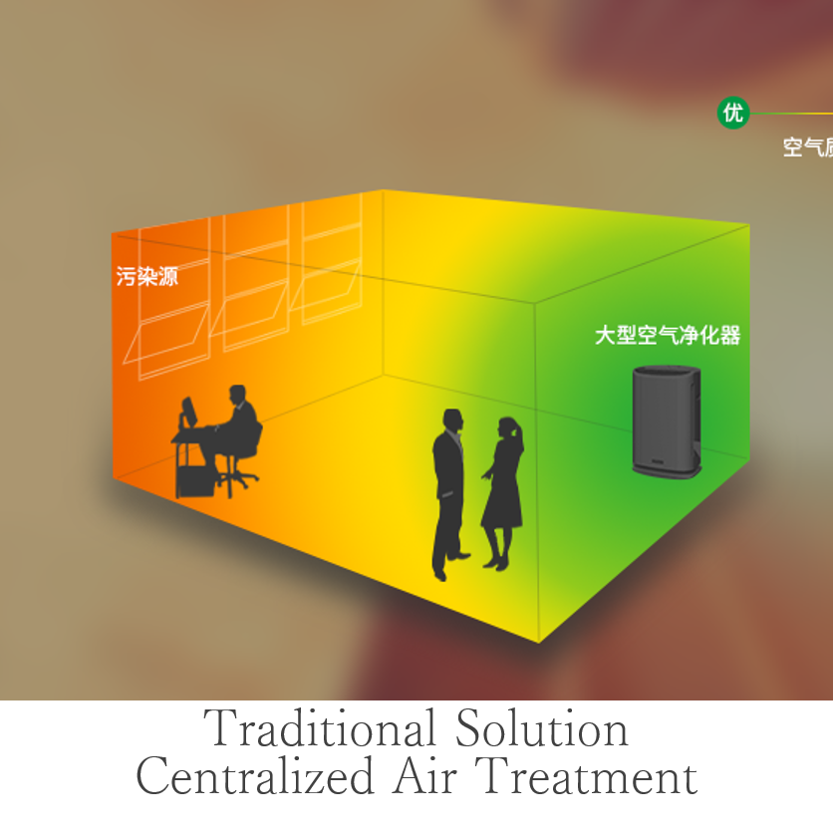
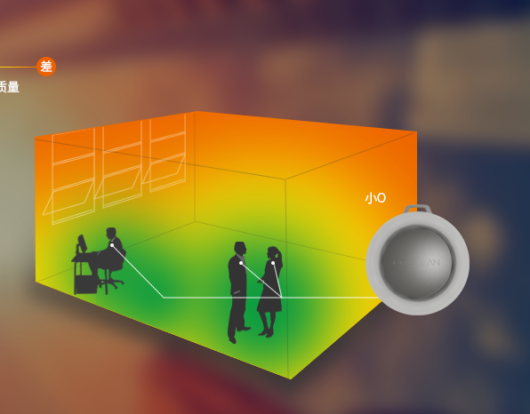
“Local-Clean” Air Treatment Targets the Need
Solution
Our Solution
Decentralized Air Treatment
Notes:
To tackle this issues, traditional solutions, which are those big HEPA air purifiers can not benefit people who are 3 meters away from the purifier, and closer to pollutant sources such as windows and air conditioning diffusers. To think it differently, our research group, together with Tsinghua U. and UCLA, created a “decentralized air” air cleaner, coclean.

Slide 6
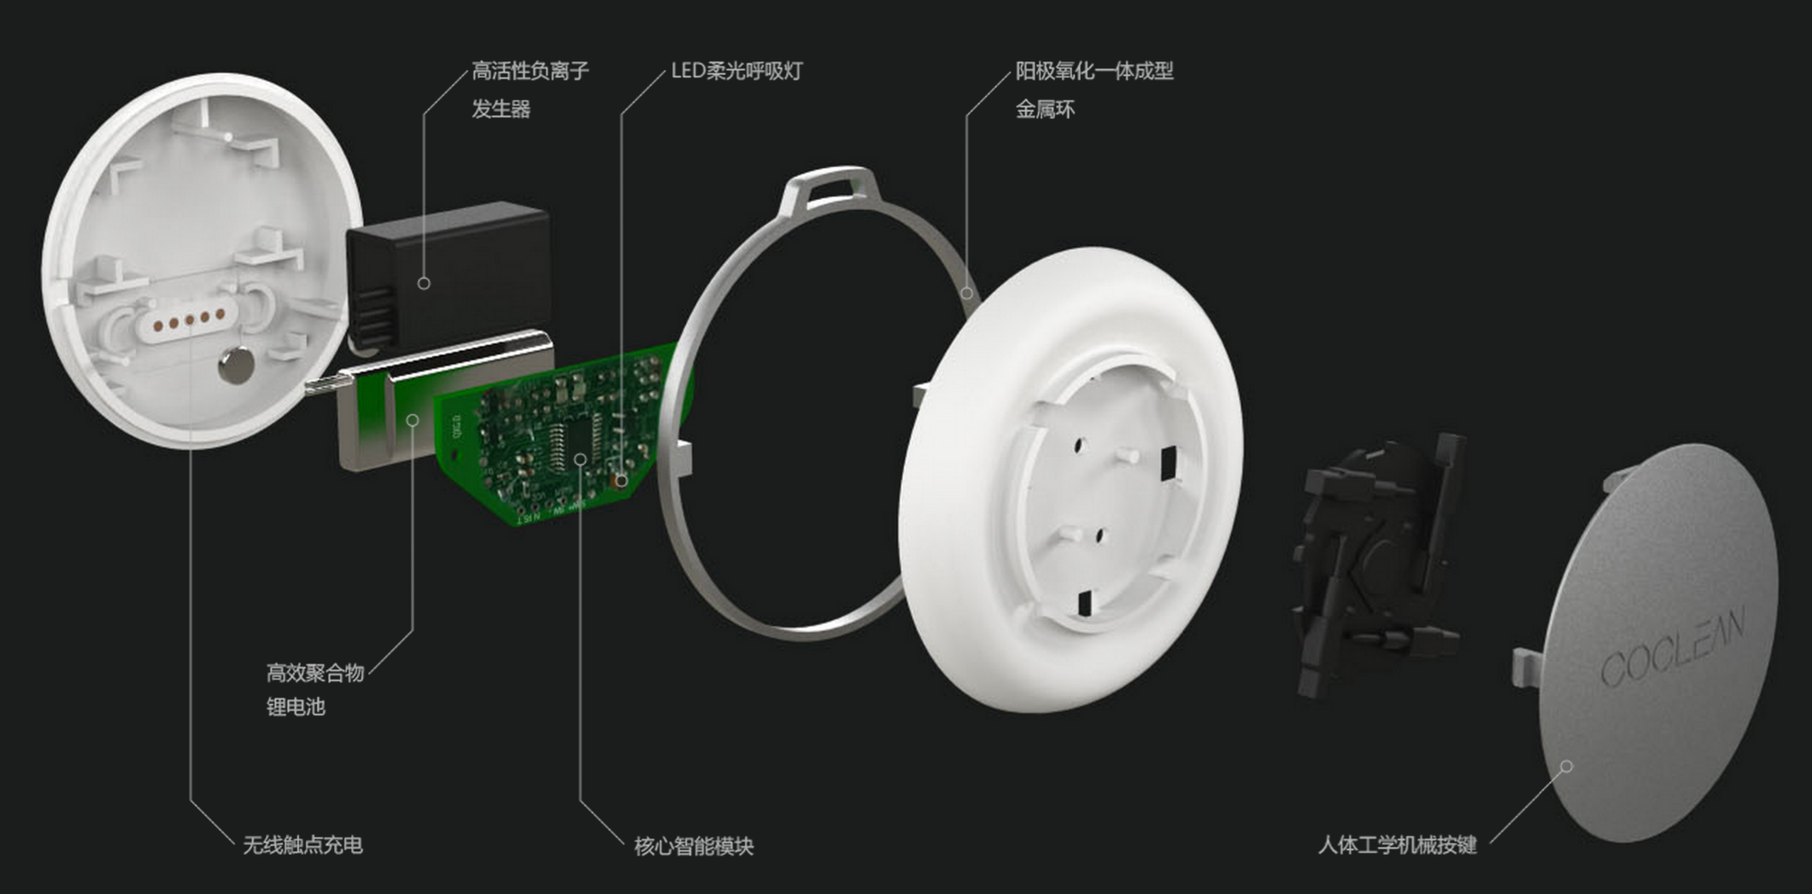
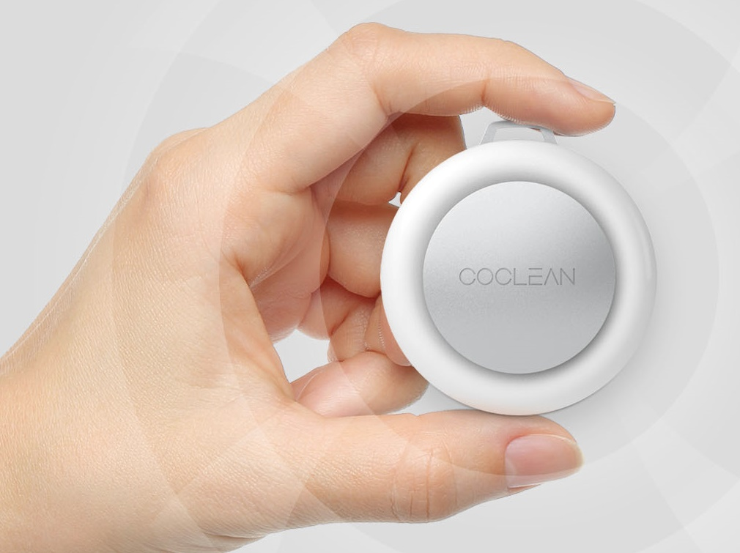
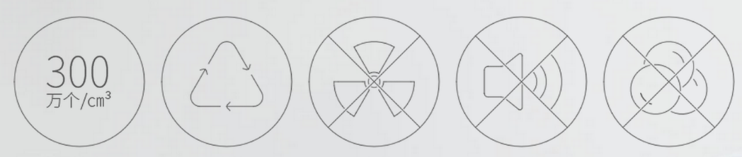
Patent-Pending Ionizing Air Purification and Monitoring Technology
Solution
Notes:
Coclean is using a patent-pending ionizing technology that emits ions to the air and captures suspended particles in the air. It doesn’t have any fan or filter. You just need to charge the battery everyday. And it’s super quiet.

Slide 7
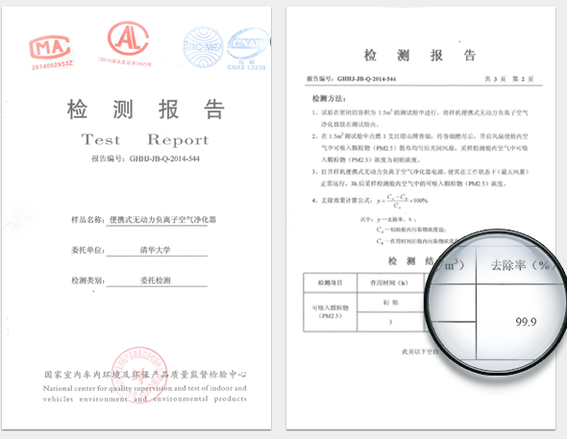
Patent-Pending Ionizing Air Purification and Monitoring Technology
Solution
Notes:
Is it effective? It’s effective for a relatively small area. According to a third party testing authority, coclean can remove 99.9% of PM2.5 within a 1.5m3 space in less than 10 minutes.

Slide 8
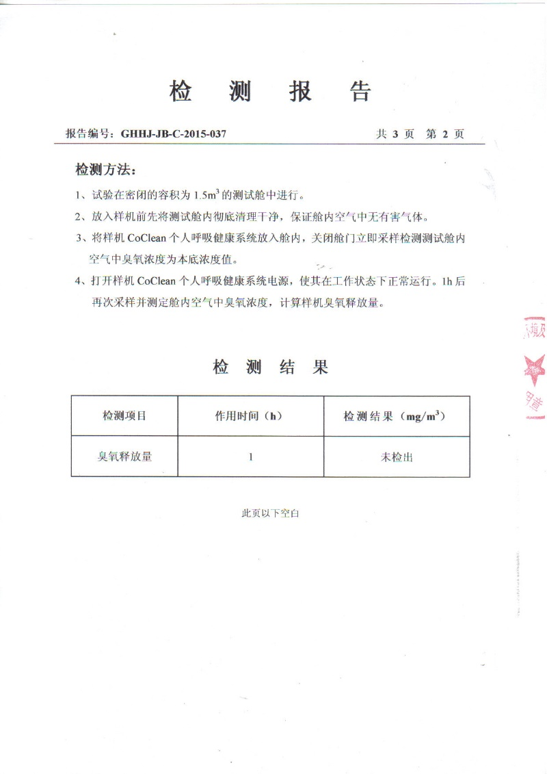
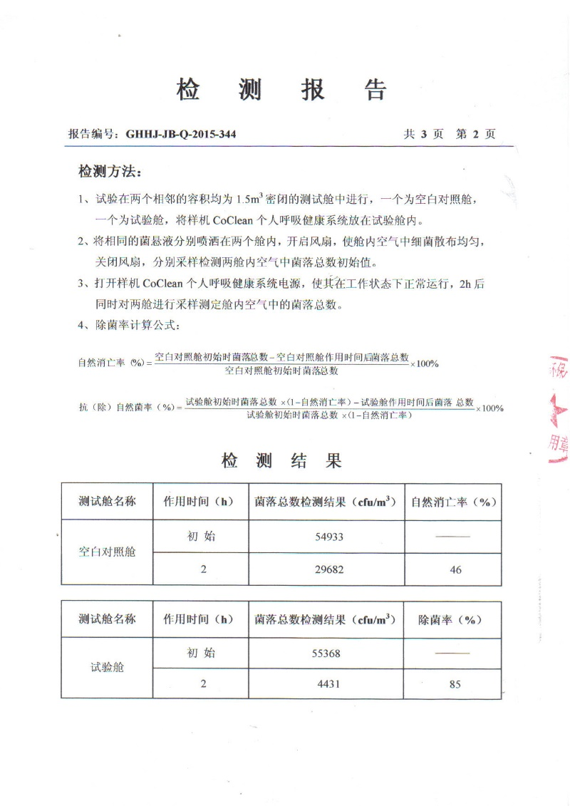
Patent-Pending Ionizing Air Purification and Monitoring Technology
Solution
No Ozone Release
Bacterial Colony Remove 85%
Notes:
Is it effective? It’s effective for a relatively small area. According to a third party testing authority, coclean can remove 99.9% of PM2.5 within a 1.5m3 space in less than 10 minutes.

Slide 9
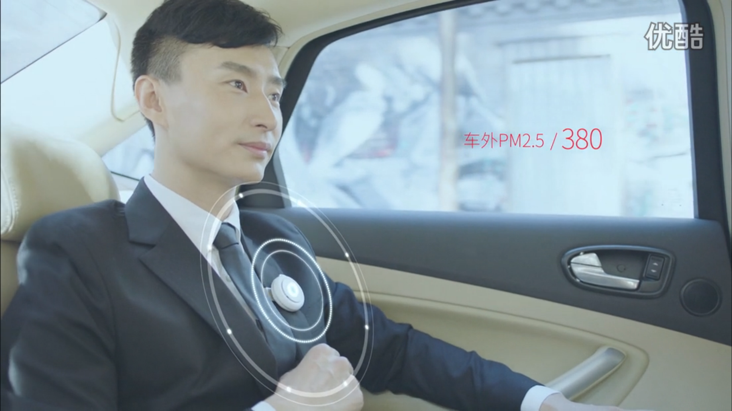
Notes:
Usage scenario

Slide 10


Slide 11
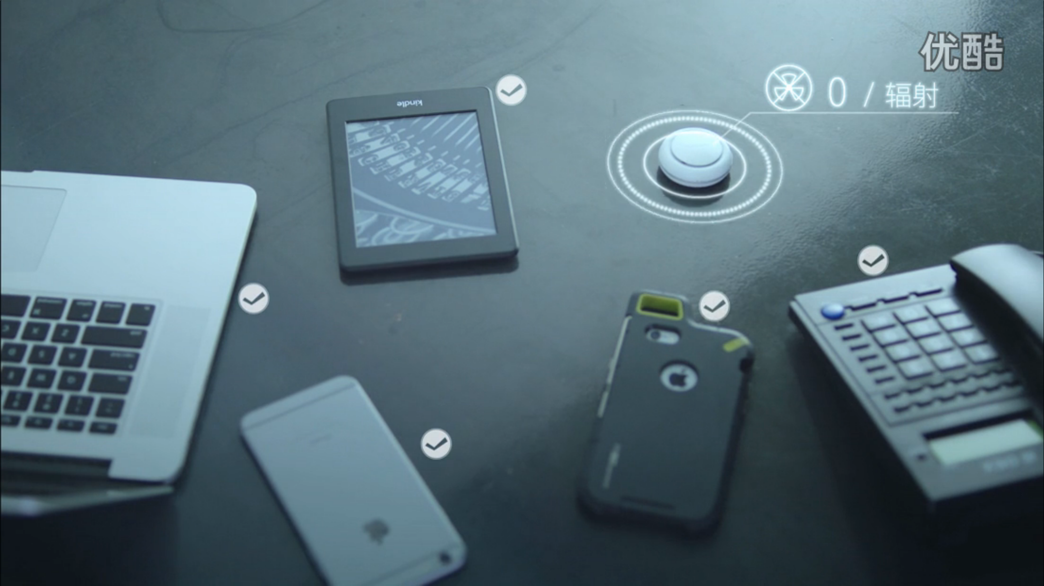

Slide 12
COCLEAN is not a normal air cleaner.

Slide 13
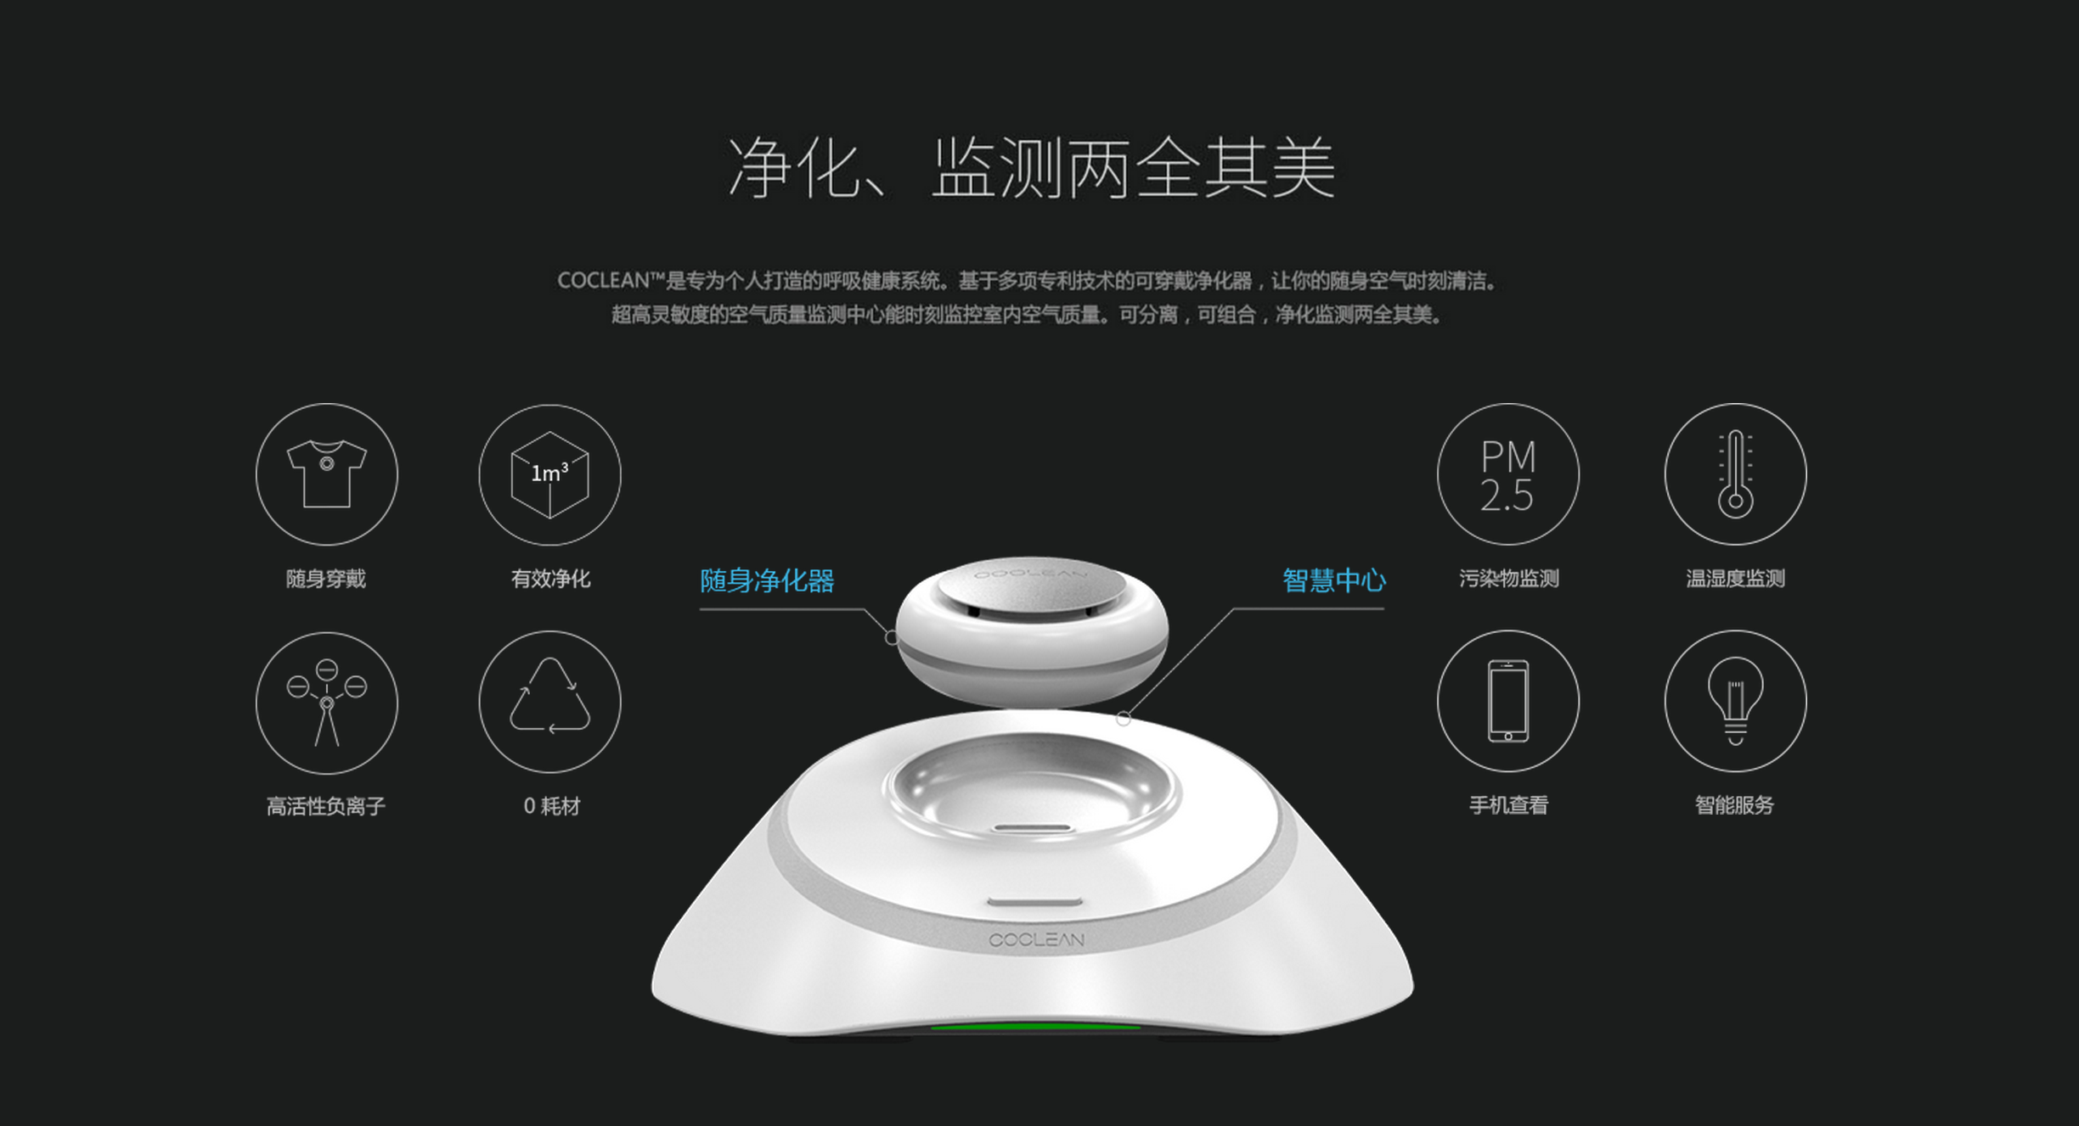
Monitoring Environment Status While Purifying
Portable Air Cleaner
Portable
Efficient
Pollutant
Temperature & Humidity
Active Ions
0 Consumables
Remote Notification
Intelligent Control
Charging Station
Notes:
We add a smart charging station for coclean. The station measures indoor air quality, temp and humidity, and sends real time data to the cloud through wifi. We also developed algorithms to turn the system modules on and off to measure both background and effective data simutaniously.

Slide 14
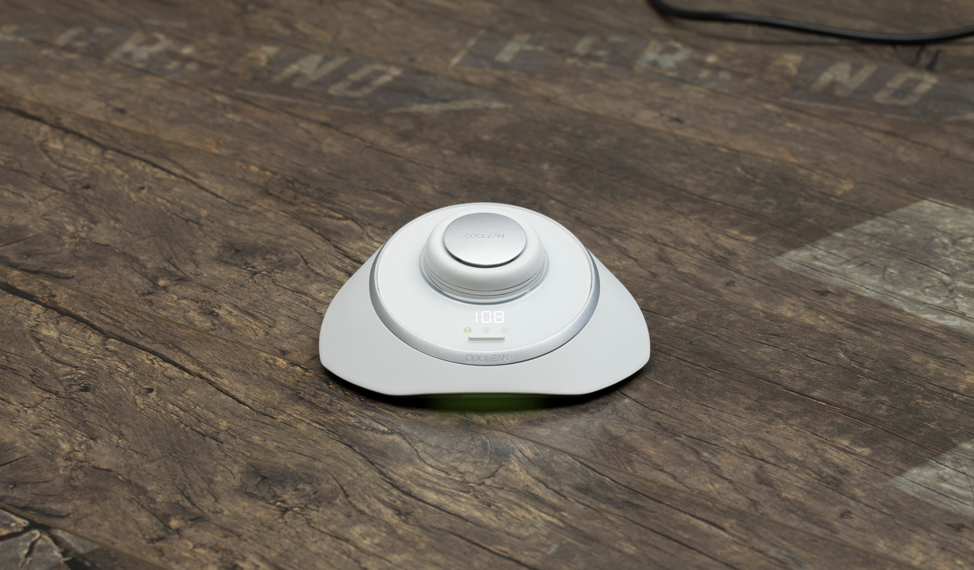

Slide 15


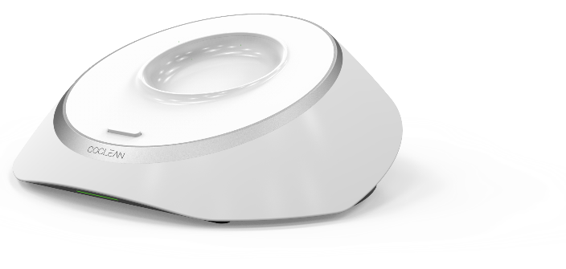
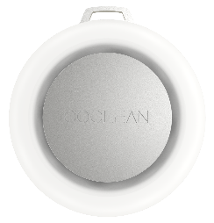

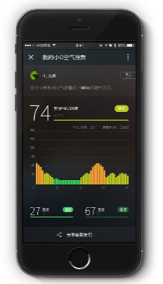

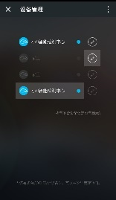
System Uploads Real-Time IAQ Data to the Cloud
Product
Cloud
Uploads data every 15min
Portable Air Cleaner
Charging Station
App

Slide 16
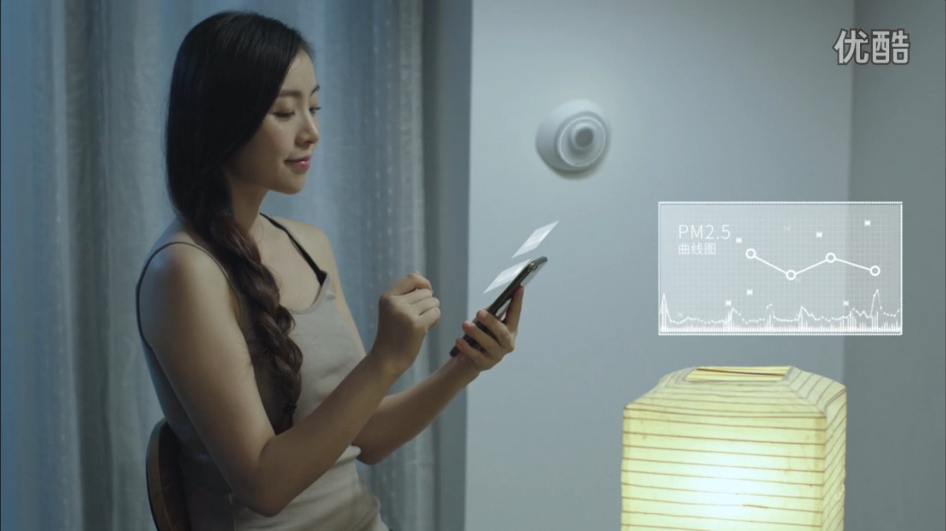

Slide 17
COCLEAN is more than an air cleaner.

Slide 18




Service
COCLEAN-Analytics Enables Large-Scale Monitoring
User Provides
User info, location, IAQ data
COCLEAN Provides
Weather, GIS, Facility Data, etc.
IAQ Time Series Data
+
Pattern Recognition
=
Scalable Impact
1
2
3
Pattern Reco.
Dev. Model
Using computer simulation
Eval. IAQ
According to national standards
Effective, efficient, low cost, scalable IAQ monitoring and diagnostics for all CoClean users
Notes:
Our team collectively have over 30 years of experience in indoor air quality and energy efficiency. We developed Coclean-Analytics engine that goes through pattern recognition, statistical and thermal modeling to anlyze data collected by coclean in real time, and provides suggestions on the operation of the building.

Slide 19
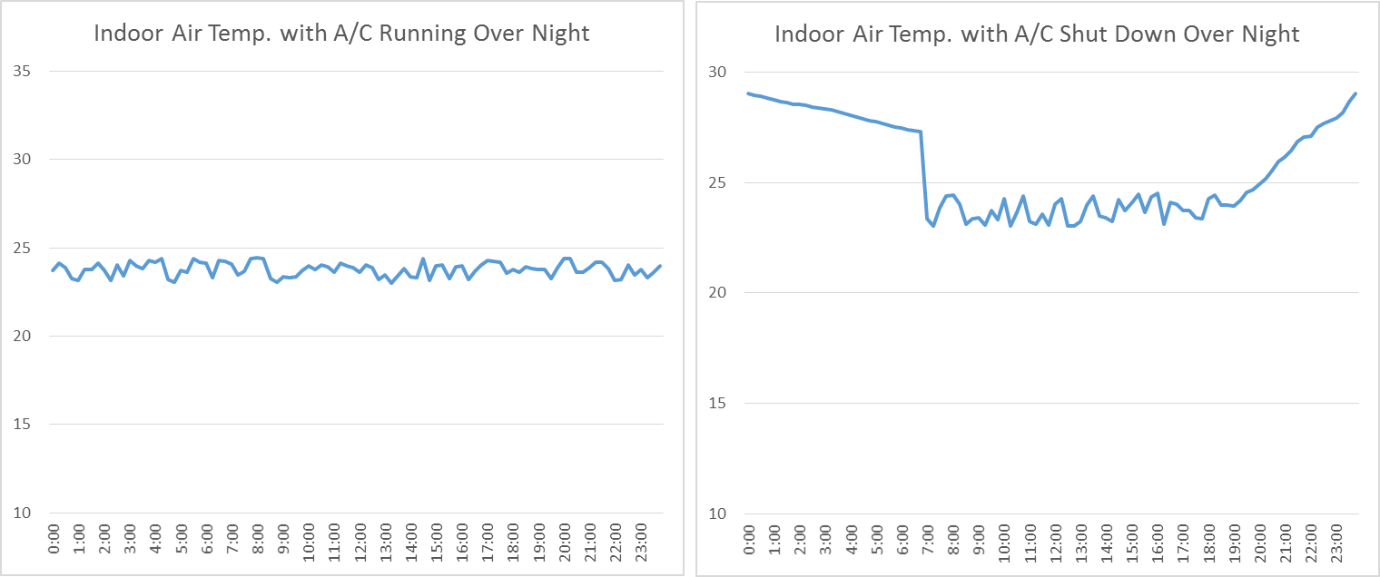
Service
COCLEAN-Analytics Enables Large-Scale Building Energy Efficiency
High Electricity Consumption
Good Practice
Notes:
In this use case, for example, Coclean indicats that the building should have turned off its air conditioning system overnight, but it didn’t. This diagnostics can be performed without installing any sensor/control module/Nest (which has compatibility issues in many countries). All you need is the coclean personal air cleaner.

Slide 20
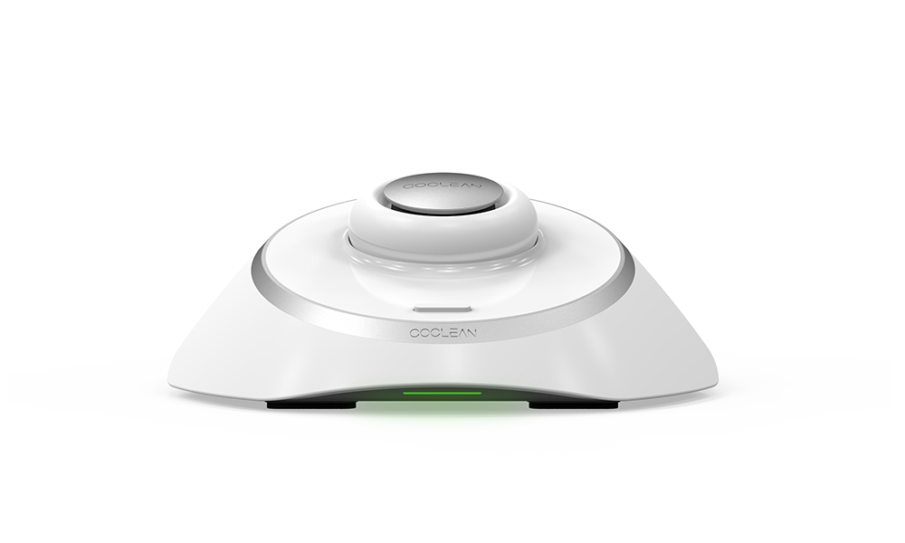
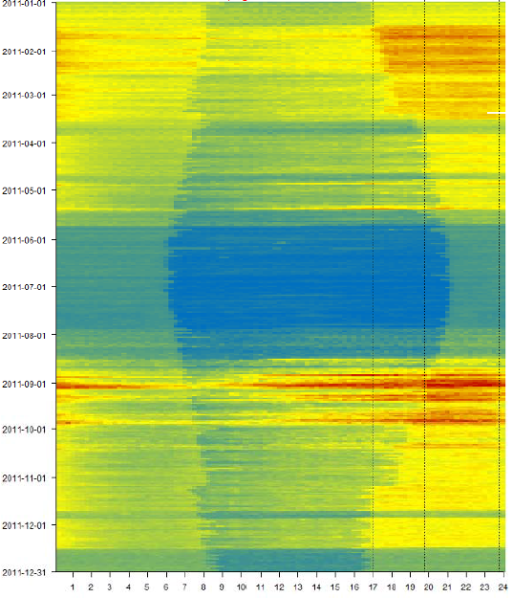

COCLEAN Hardware
Service
COCLEAN Enables Scalable Building Energy Efficiency Audit
COCLEAN-Analytics
Online Audit Report
Notes:
So, what is coclean. Coclean cleans local air, measures indoor environment, and gives both indoor air quality and energy efficiency of the building.

Slide 21
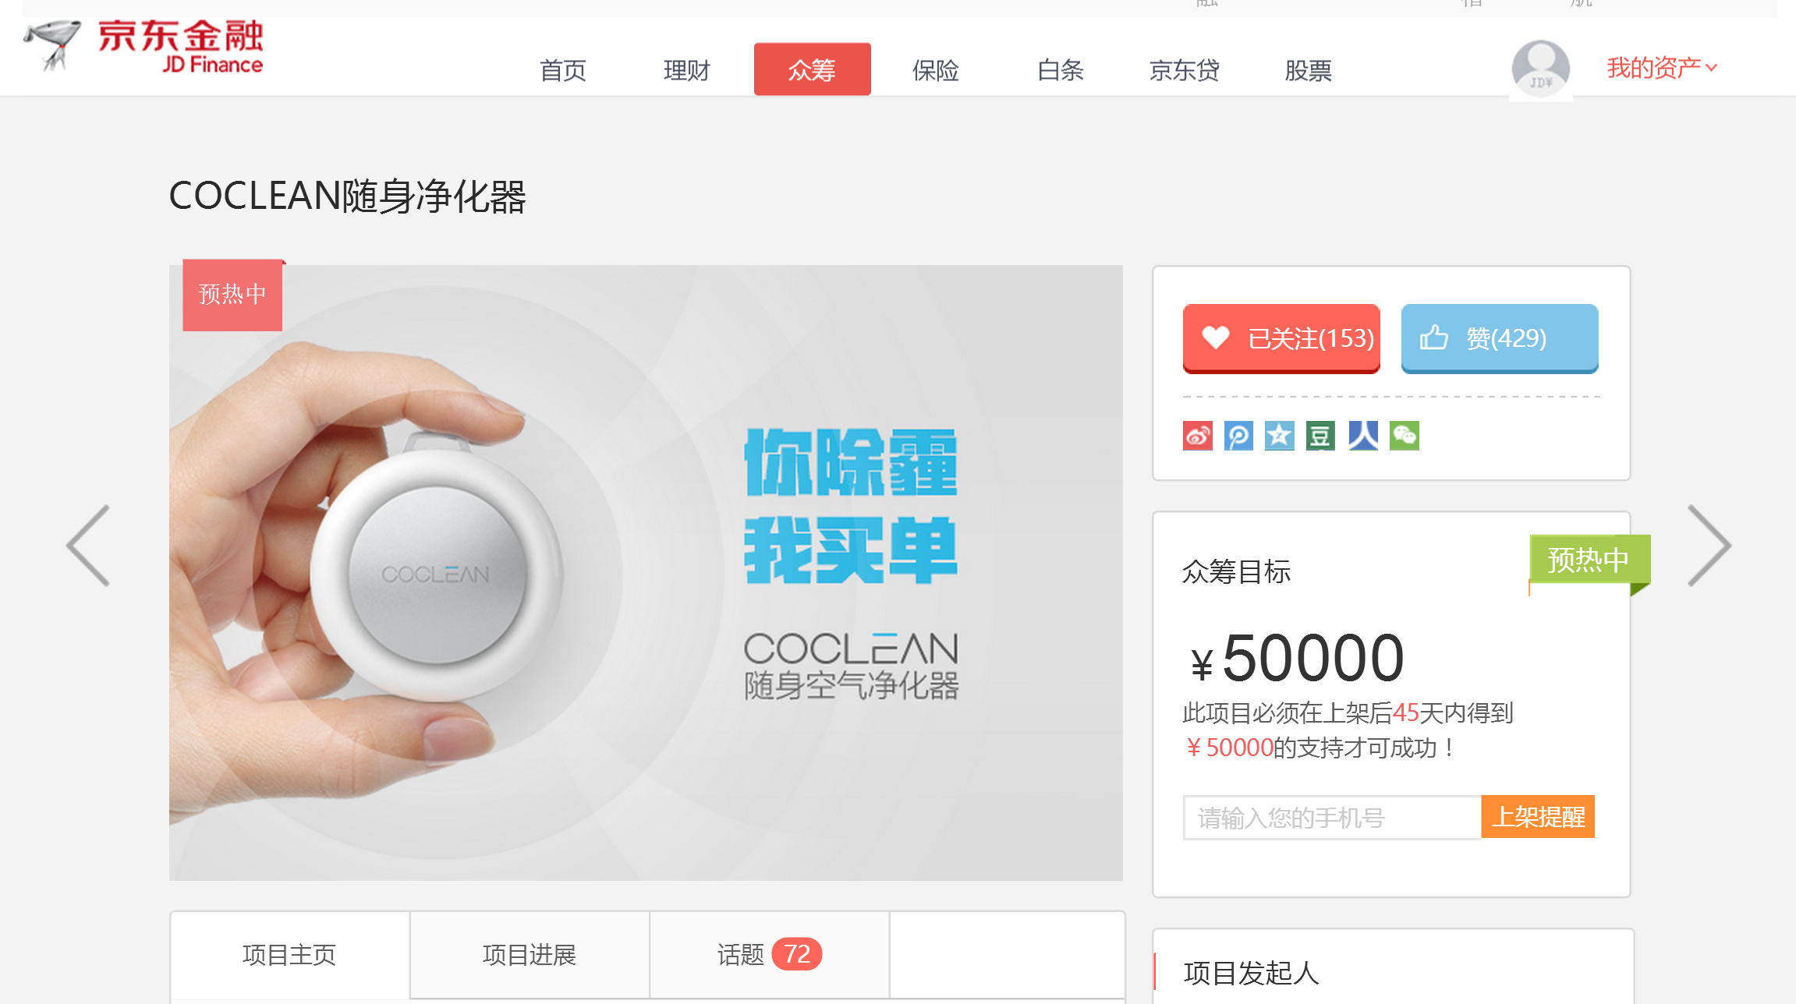
Service
JD Crowd-Funding Campaign Started Yesterday!
Notes:
We started our JD crowd funding campaign yesterday and reached our target in less than two hours. Together with our customization deals, our total sales this month is over 300k yuan.

Slide 22
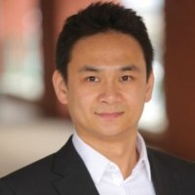


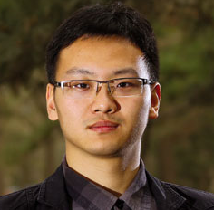













Executive Team
Team
Fei Zhao CEO
Ye Zhao COO
Yu Wang CTO
Yi Su ID
H. Zhang Products
Ph.D. in Building Science
Building Energy Scientist
Graduate Researcher on Building Science
Multiple-Patent Holder
Hardware and Software Hacker, Entrepreneur
Co-Designer of Dubike
Product Designer
Product Manager of Meitu Phone & Kingsoft
Notes:
Our team have collectively over 30 years of experience in building science and energy efficiency. Before starting coclean, I was chief scientist of a US building data analytics company and analyzed over 3b sqft of building space. We are also working with Tsinghua U, Harvard and UCLA on Research&Development.

Slide 23




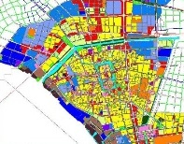
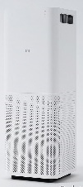
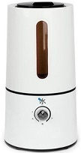
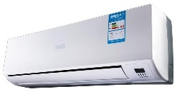

Roadmap: A Matrix of Building Appliances towards a Better Built Environment
？
COCLEAN
Personal Air Companion
COCLEAN
Smart Window Frame
COCLEAN
Smart Heater
COCLEAN
Crowd-Controlled A/C
Other Smart Appliances for Built Environment
API
COCLEAN Intelligence Center
Weather, GIS, etc.
3rd Party Products
COCLEAN-Analytics: Indoor Environment Quality Analysis Engine

Slide 24


Data-Driven Technology for Better Built Environment
Ye Zhao, Co-Founder & COO
Zhao.ye@coclean.com
Notes:
That’s coclean. We provide data driven technology for better built environment. Thank you.

